Slide 1



Use of Experts: A View From Both Sides of the Bench
Judge Elizabeth Gill, Franklin County Court of Common Pleas, Domestic Relations and Juvenile Branch
and
Julia L. Leveridge, Esq., Kemp, Schaeffer & Rowe Co., L.P.A.

Slide 2

Agenda
1 – Working with the Expert
2 – Preparing for Trial
3 – Tips for Use of Different Experts

Slide 3
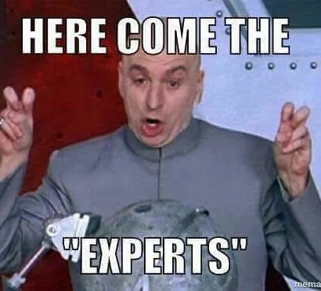
-1- Working with the Expert

Slide 4
1 – Working with the Expert
a. Keep in Mind the Role of the Expert
i. Tell the “story” in a divorce
ii. As it relates to evidence: Gather it, analyze it and interpret it
iii. Using a peer reviewed, generally accepted methodology
iv. Abiding by applicable rules
v. In a manner acceptable to the Court

Slide 5
1 – Working with the Expert
b. Use the forensic expert you have retained to help you from the beginning;
i. Assist you in the discovery process
• Interrogatories
• Request for Production of Documents
ii. Prepare written report (if necessary or required)
iii. Assist with deposition and cross-examination of opposing expert

Slide 6
1 – Working with the Expert
c. Use your expert to do the following for you:
i. Methodology
ii. Analysis
iii. Background on the other expert
• Previous testimony or valuations
• Reputation
• Speaking presentations

Slide 7
1 – Working with the Expert
d. Assessing the Expert’s Credentials: Forensic Accountant
i. CBA – Certified Business Appraiser (Institute of Business Appraisers)
ii. ASA – Accredited Senior Appraiser (American Society of Appraisers – less experienced)
iii. ABV – Accredited Business Valuator (AICPA)
iv. CFA – Chartered Financial Analyst (AIMR)
v. CVA – Certified Valuation Analyst (National Association of Certified Valuation Analysts)

Slide 8
1 – Working with the Expert
e. Assessing the Expert’s History:
i. Has the expert ever valued a company in this industry or testified in this area before?
• How many?
• What was different or similar to this valuation?
• Describe the company, the value, the situation, and the outcome of the valuation
ii. How many valuations/evaluations overall?
iii. What purposes?

Slide 9

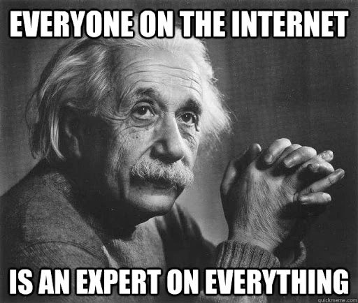
1 – Working with the Expert
f. Assessing the Expert’s Articles:
i. Any articles listed on the expert’s CV? See if you can find and read them!
ii. Google the Expert – You might be surprised!

Slide 10
1 – Working with the Expert
g. Assessing the Expert’s Bias
i. Valuations for different purposes – Divorce, Estate, Shareholder Disputes = Fair Market Value
ii. Nor impartial and objective analysis:
• Routinely testify for retaining attorney or firm in the past?
iii. Any relationships with the party or industry?
• How is the expert perceived in the industry?

Slide 11
1 – Working with the Expert
h. Assessing the Expert – Other:
i. Is the opinion based upon reliable information?
ii. What facts or data has the expert relied upon?
iii. Reliance upon publications or treatises.
iv. Drafts of opinion(s).
v. Solicit endorsement of your expert report or parts thereof.

Slide 12
1 – Working with the Expert
i. Assessing the Expert’s Qualifications:
i. The expert will qualify based upon skills, knowledge, education, experience and training.
ii. Other considerations:
• Can the theory or technique be tested?
• Has the theory or technique been published or subject to peer review?
• Is the theory generally accepted?

Slide 13
1 – Working with the Expert
j. Assessing the Expert’s Preparation – the expert should be prepared to describe the following:
i. Who first contacted you?
ii. When were you first contacted?
iii. When were you retained?
iv. Who assisted you with this engagement?
v. What was any assistant’s role?

Slide 14
1 – Working with the Expert
k. Assessing the Expert at Deposition Prior to Trial – Sample Questions
i. What assumptions did you make?
ii. What is the factual basis for your opinion, and how do these facts lead to your conclusion?
iii. What information have your relied on that was provided by counsel or your client?
iv. What precise facts and data did you rely on?
v. What concerns do you have regarding your conclusions?
vi. Under what circumstances would you use a different methodology?
vii. What alternative hypotheses could explain what you observed?
viii. How much time did you spend on this engagement? Why not more or less?

Slide 15
1 – Working with the Expert
k. Assessing the Expert at Deposition Prior to Trial – Sample Questions
ix. Did you personally do all of the work that led to your opinions?
x. How much time did you spend on this report as opposing to others in your office?
xi. What other work would you have liked to have performed?
xii. What things, if any, do you agree with in the other expert’s report?
xiii. What would you say are the main weaknesses of the other expert’s report?
xiv. Did the opposing expert depart from the standards of the profession?
xv. Is there any other information you need for any other work you feel you must do in order to finish or double check your report?
xvi. Does your report contain all of the opinions you plan to give at trial?

Slide 16
1 – Working with the Expert
k. Assessing the Expert at Deposition Prior to Trial – Sample Questions
xvii. Do you plan to do additional work before trial?
xviii. What did you discuss with company personnel?
xix. Were any limitations placed on your work?
xx. Why were some documents in this case withheld from you?
xxi. Did you ask for documents you did not receive?
xxii. So all of the documents you received in this case came from counsel?
xxiii. Have you reviewed any books, treatises, articles or other written works in connection with your work in this case?
xxiv. How many draft or preliminary reports did you prepare before you finalized your report in this case?
xxv. Did you discuss your report with counsel before issuing your report?
xxvi. What changes did you make to your report?

Slide 17
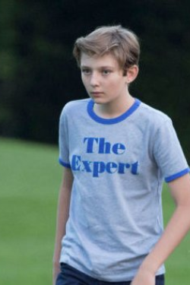
1 – Working with the Expert
l. Assessing the Expert at Trial – Cross Examination
i. Potential goals of cross-examination
• Make the trier of fact think that your cross-examination was successful
• To discredit the expert and his/her conclusions
• Have the expert change or modify opinions
• Advance the opposing theories
• Get the expert to step outside of his or her area of expertise

Slide 18
1 – Working with the Expert
l. Assessing the Expert at Trial – Cross Examination
ii. Typical areas for cross examination
• Fees
• Pointing out the subjectivity in the opinion
• Impeachment with prior statements/opinions
• Mathematical or other errors
• Lack of experience/work
• Bias
• Opinions that are inconsistent
• Assumptions
• Show the expert “new” evidence
• Information the expert did not consider
• Use of learned treatise/authoritative text

Slide 19
1 – Working with the Expert
l. Assessing the Expert at Trial – Cross Examination
iii. Demeanor of the Expert – advising your expert for cross-examination
• Do not be argumentative, not advocate for the client, expert is an advocate of his or her opinion
• Maintain the same demeanor on cross as direct
• Concede points that should be conceded
• Listen very carefully to the question
• Be respectful and polite if he or she needs the question repeated or rephrased
• Use proper names and be professional
• Understand who he or she is and what his or her strengths are

Slide 20
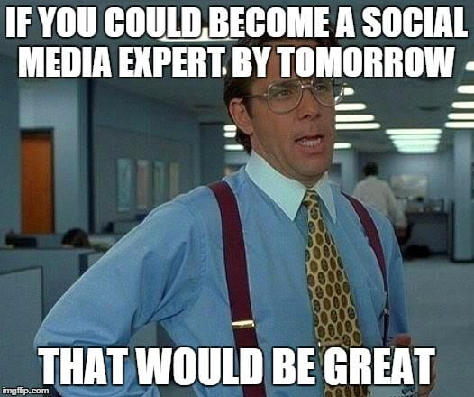
-2- Preparing for Trial

Slide 21
2 – Preparing for Trial
Provide copies of opposing party expert reports to your expert and meet with them to analyze the report and develop questions for cross-examination.
This is key for asking the right questions – they will often give you most of the questions you will need to ask so that your expert can take apart the opposing party’s report when it is their turn to take the stand.

Slide 22
2 – Preparing for Trial
Preparation is key.
You are not the expert! Your client is paying an expert, so use the expert and have him or her teach you what you need to know. The bulk of this work should be done with the documents before trial, mediation, or settlement conference.
You need time to digest and understand the material.

Slide 23
2 – Preparing for Trial
Familiarize yourself with the documents that your expert wants to use at trial!
You need to know not only what you are going to have the expert use, but in what order, and why. The questions you have developed with your expert will make this easy.
Not actually taking the time to look at the documents yourself prior to trial is an invitation to disaster!

Slide 24
2 – Preparing for Trial
Meet with the expert and your client prior to trial to practice direct testimony, cross-examination, and to practice, maintain, and reinforce their familiarity with the documents you will be using at trial.
Sometimes getting everyone in the same room will lead to new takes on weaknesses in the analysis at this pre-trial stage, and help you develop strategies to strengthen your position with the Court. Does your client have a horrible memory for numbers?
You need to be prepared to lead them through the documents, but not in such a boring fashion that you will lose the Court’s interest.

Slide 25
2 – Preparing for Trial
e. Are there issues that are bifurcated for multiple hearings? Analysis in stages aimed at each issue that will be tried is appropriate, and working through this with your expert early on can save lots of scrambling on the eve of trial or court deadlines.
Example: a “De Facto” date of divorce
Another Example: Contested prenuptial agreements

Slide 26
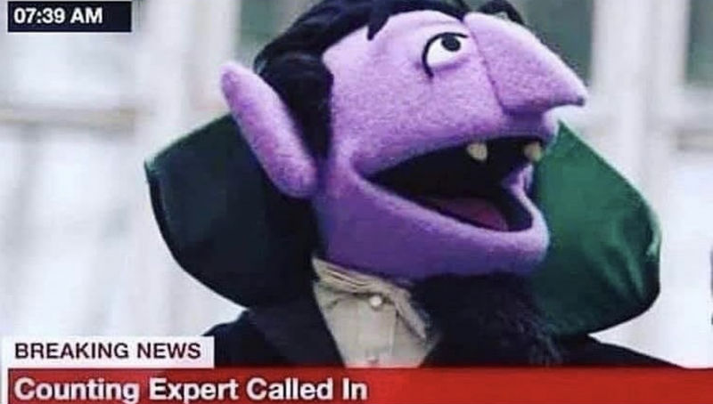
3 – Tips for the Use of Different Experts

Slide 27
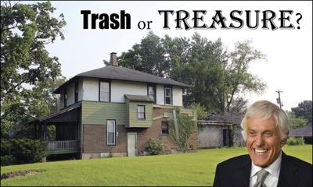
Real Estate Appraisers

Slide 28
3 – Tips for the Use of Different Experts
a. Real Estate Appraisers
i. Valuation is especially important for real estate, namely the marital home, because it is often one of the most valuable assets owned by a couple. Being familiar with the basics of valuation methods for real estate and the role of an appraiser can help you reach a fair and reasonable agreement on the value of real estate owned between the spouses and how it should be divided between the parties.
ii. Most spouses have a marital home. A home can be a single-family house, a condo or co-op, or even a mobile or trailer home. Some couples may have vacation or second homes, or maybe a timeshare. Non-residential property includes investment property, farmland, and business property used in the owner’s business. The monetary value of all of these kinds of real property must be assessed in a divorce.

Slide 29
3 – Tips for the Use of Different Experts
a. Real Estate Appraisers
iii. Two valuation methods are commonly used with real estate in a divorce case.
The Market or Sales Comparison Approach compares a property to recent sales of similar properties.
The Capitalization of Income approach is based on the net income that a property will generate. A present worth is then determined. This complex method is often used for investment properties.

Slide 30
3 – Tips for the Use of Different Experts
a. Real Estate Appraisers
Obtaining appraisals or valuations of real property assets is a necessity.
The law requires judges to determine the fair market value of marital assets before deciding property division issue. While judges may refuse to make decisions without this information, they may act on information provided by just one spouse. It is best to obtain the services of a professional appraiser.
Sources for finding the right appraiser include: State licensing boards for real estate appraisers; Appraisal societies and associations, such as the American Society of Appraisers ; Securities organizations, such as the Federal Analysts Federation; Trade organizations; Bar associations; and Business brokers. A court can also order appraisals of certain property.

Slide 31

Custody Evaluators

Slide 32
3 – Tips for the Use of Different Experts
b. Custody Evaluators
A custody evaluator may suggest or sometimes at the request of a client or opposing party, one may choose to undergo psychological testing.
A certain the style of test employed is both relevant and to the extent possible, reliable. Keep in mind that virtually none of these were designed with any form of legal standard in mind.
However, with that said, in the right setting they can prove useful. The following are a few of the common psychological tests and standards that are employed in custody evaluations.

Slide 33
3 – Tips for the Use of Different Experts
b. Custody Evaluators
Diagnostic and Statistical Manual of Mental Disorders Fourth Edition Text Revision.
An updated version of the DSM, now the DSM-V or Fifth Edition has been published as of May 18, 2013. It is the standard classification of mental disorders used by mental health professionals in the United States intending to be applicable in a wide array of contexts and used by clinicians and researchers of many different orientations (e.g., biological, psychodynamic, cognitive, behavioral, interpersonal, family/systems).
The diagnostic and Statistical Manual of Mental Disorders, Fifth Edition (DSM-5) is the current edition and has been designed for use across clinical settings.

Slide 34
3 – Tips for the Use of Different Experts
b. Custody Evaluators
iii. The Minnesota Multiphasic Personality Inventory is considered a protected psychological instrument, meaning it can only be given and interpreted by a psychologist trained to do so and therefore, you cannot find the test online. While it’s commonly administered by computer (and requires no direct professional involvement during its administration), psychological testing is nearly always preceded by a clinical interview by the psychologist who is doing the testing. After the computer scores the test results, the psychologist writes up a report interpreting the test results in the context of the person’s history and current psychological concerns.
iv. The MMPI is made up 10 clinical subscales, which are a result of answering certain questions on the test in a specific manner.

Slide 35
3 – Tips for the Use of Different Experts
b. Custody Evaluators
Medical Records.
If you have determined that medical records and other mental health evidence would be relevant and useful in your case, you need to acquire a complete copy of the records.
If they are your own client’s records, this can be fairly straight forward, and your client can request a copy of all of their own medical records.
If it is the opposing party’s records, you may need a court order to view the records or you can attempt to gain the records through other discovery methods.

Slide 36
3 – Tips for the Use of Different Experts
b. Custody Evaluators
vi. Be aware, when dealing with medical records, you will often need a form which complies with the Health Insurance Portability and Accountability Act (HIPAA). Under HIPAA patients and their legal and authorized representatives are entitled to review medical records pertaining to their own medical treatment.
vii. Generally, the process for admitting medical evidence is serving the medical entity with a subpoena and obtaining a certified copy of the records. It is always important to check your jurisdiction’s rules to make sure you are completing all the necessary steps to admit the records in your jurisdiction. Also, remember to keep in mind HIPPA regulations.

Slide 37
3 – Tips for the Use of Different Experts
b. Custody Evaluators
Timelines
Custody evaluators will often try to put together timelines in order to better understand the family and the parents’ relationship with each other and with the children.
In the relationship timeline, often included events include: when the parents met; when the parents’ relationship became serious; when the parents began living together; when the parents got married; when the parents first separated; the total number of separations; the date of the last separation; and whether and when couples or family counseling was ever done.
In a parenting timeline, the following questions are often asked: What was each parent’s share of custody during the first six months after separation? From the six-month mark to the end of the first year after separation? When were the significant changes in the amount of time each parent had custody over the next two years? What is the current parenting plan the parents are using?

Slide 38
3 – Tips for the Use of Different Experts
b. Custody Evaluators
The purpose of the Child Custody Evaluation is to assist in determining the psychological best interests of the child.
From the court’s perspective, the most valuable contributions of psychologists are those that reflect a clinically astute and scientifically sound approach to legally relevant issues. When making recommendations, psychologists should seek to avoid relying upon personal biases or unsupported beliefs.
Recommendations should be based upon articulated assumptions, interpretations, and inferences that are consistent with established professional and scientific standards. Although there is no one right way to conduct a custody evaluation, there are wrong ways.

Slide 39
3 – Tips for the Use of Different Experts
b. Custody Evaluators
x. One way to challenge the results of a custody evaluation is to question the qualifications of the evaluators. Specifically, the Guidelines for Child Custody Evaluations in Divorce Proceedings and the Model Standards of Practice for Child Custody Evaluations indicate that custody evaluators should have specialized knowledge and training in performing psychological assessments of children, adults, and families as well as education, experience, and/or supervision in child and family development, child and family psychopathology, and the impact of divorce on children.

Slide 40
3 – Tips for the Use of Different Experts
b. Custody Evaluators
x. (Cont’d) A good place to start is to obtain a copy of the psychologist’s curriculum vitae. From the vitae, the psychologist’s training and experience working with children and families and evaluating children and families for custody purposes can be determined. If the psychologist cannot cite any references, this can be used to criticize the psychologist’s overall knowledge in the specific areas about which he or she is forming opinions and making recommendations. The number of custody evaluations that the psychologist has conducted also is a question that should be asked in order to determine the psychologist’s qualifications and experience.

Slide 41
3 – Tips for the Use of Different Experts
b. Custody Evaluators
xi. At a minimum, a custody evaluation should involve both parents, the minor child(ren), observations of the parent-child relationships, and contact with relevant collateral sources.
If an evaluator does not evaluate both parents and the child(ren), he or she cannot and should not make recommendations about custody or time sharing.
In order to cross examine an adverse psychological witness properly, it is essential to review all of the notes and information collected during the evaluation. The purpose of reviewing the notes, of course, is to find any errors in the information or lack of specificity in the notes.

Slide 42
3 – Tips for the Use of Different Experts
b. Custody Evaluators
xii. Although psychological testing is the part of the evaluation usually most foreign and confusing to attorneys, knowing some basic information about psychological testing can be helpful in both preparation and cross examination. Validity, reliability, and a strong research base are important factors in the selection of psychological tests in forensic cases.
A psychological consultant can obtain the actual test data, re-score it to make sure it was scored and interpreted correctly (many times it has not been), provide consultation, elaborate on the strengths and weaknesses of the overall evaluation, and assist in preparing for deposition or trial questioning of the custody evaluator.

Slide 43
3 – Tips for the Use of Different Experts
b. Custody Evaluators
xiii. Always make notes of discrepancies and/or omissions, as attorneys can point these out to the custody evaluator and he or she may be willing to amend the custody evaluation report. The discrepancies must be significant and verifiable for the custody evaluator to make revisions to the custody evaluation report. Also, be sure to check the Custody Evaluation Guidelines.
The American Psychological Association has established guidelines for custody evaluations. Have the Custody Evaluation reviewed. Experts in custody evaluations will be able to review custody evaluation for methodological flaws including signs of bias, failure to follow established guidelines and gaps in data
In addition to receiving a copy of the custody evaluation, be sure to receive a copy of the custody evaluator’s curriculum vitae.

Slide 44
3 – Tips for the Use of Different Experts
b. Custody Evaluators
xiv. Remember, custody determinations are often the most difficult decisions for judges, and they will rely heavily on expert’s opinions so know your expert’s expertise. Do they specialize in children or adults? Are they knowledgeable and capable of recognizing abuse settings? Do they have any particular tendencies in their recommendations?
Be prepared to attack weaknesses in your opponent’s evaluation and to highlight the strengths of yours. This can be as simple as knowing whether the expert was appointed by the court or hired by the opposing party. Is the expert rattling off field specific terminology that sounds dire but really has little application to the relevant legal standard?
Make sure your expert knows the law of the jurisdiction and highlight when the opposition does not.

Slide 45
3 – Tips for the Use of Different Experts
b. Custody Evaluators
xv. The report should clearly present the evaluator’s opinions and recommendations as well as the basis for these opinions and recommendations.
In doing so, it should include a description of all of the data relied upon in the evaluation, including parent and child interview information, test results, parent-child observations, collateral source information, and whatever records were reviewed and relied upon.
If any of these essential parts are lacking within a custody evaluation, it can create a question of the accuracy and thoroughness of the evaluation and it should be questioned.

Slide 46
3 – Tips for the Use of Different Experts
b. Custody Evaluators
xvi. Expect to cover the following:
• Is the report complete? Is there a significant flaw?
• Was the evaluation process conducted sloppily?
• Are identified weaknesses probative? Do they demonstrate unreliable conclusions?
• Were interviews with parents conducted in a balanced manner? Were they neutral, unbiased and sufficiently in-depth so each parent could respond to other parent’s views? Did the evaluator ask each parent the same questions?
• Were interviews with the child age-appropriate, development-appropriate and sufficiently in-depth to glean the child’s moods and relationship with each parent?
• Were case records and evaluation data properly integrated?

Slide 47
3 – Tips for the Use of Different Experts
b. Custody Evaluators
xvi. Expect to cover the following:
• Were collateral informants reviewed fairly? Were essential collateral informants contacted? Did the evaluator explain why certain collaterals were not contacted (redundancy, unavailable)? Was a log kept of phone and in-person contacts?
• Was data properly analyzed in forming conclusions and recommendations? Were multiple hypotheses considered?
• Was case data properly integrated into the report?
• Were recommendations logically connected and consistent with the data? Was any conclusion supported with inadequate or insufficient data? Did the evaluator choose only the data that supported a conclusion?
• Did the evaluator get the important facts correct? A significant factual error could render the evaluation useless.
• Is there any indication that the evaluator was biased, prejudiced or discriminated?
• Did the evaluator misrepresent test results or incorrectly score a test?

Slide 48
3 – Tips for the Use of Different Experts
c. Vocational Evaluator
i. The purpose of evaluation is to assess current and/or future employability and wage-earning capacity for the court. It can include the presentation of a vocational plan outlining specific details as to how the person will return to the job market (e.g., training time, cost, appropriate programs, entry/ceiling earnings upon plan completion, and job availability).
ii. This procedure is not a method for the diagnosis or treatment of psychological problems nor does it allow for career counseling over a period of time (i.e., job development, job placement) unless it was part of the referral. Vocational tests cannot be failed, but are used only as a means of identifying the person’s strengths, interests and personality, work values, and transferable work skills.

Slide 49
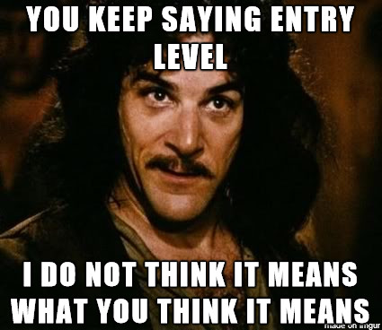
Vocational Evaluators

Slide 50
3 – Tips for the Use of Different Experts
c. Vocational Evaluator
The vocational/career assessment is a master’s level occupation.
With three years of professional experience and recommendations from supervisors, a person can sit for a written examination leading to Board certification as a National Certified Counselor (NBCC) followed by application to sit for a written examination covering five competency areas of career counseling.
With successful passage, the person becomes a National Certified Career Counselor (NCCC) through the National Council for Credentialing Career Counselors, National Vocational Guidance Association.
The designation of Certified Rehabilitation Counselor (CRC) is also available through a state certification process.

Slide 51
3 – Tips for the Use of Different Experts
c. Vocational Evaluator
iv. The first step is usually a diagnostic interview, which is a question/answer procedure to gather pertinent information affecting employability (e.g. work/life experiences, health, age, length of absence from the work force, educational background, vocational/career goals or priorities, motivation, an d current family/personal situation). This will also be your opportunity to ask any questions you may have regarding this evaluation process.

Slide 52
3 – Tips for the Use of Different Experts
c. Vocational Evaluator
The next step is vocational testing.
There are a wide variety of vocational testing instruments used to assess employability. In general, these instruments cannot be passed or failed but are used to develop a work trait profile.
The following areas are covered: Ability/aptitudes (i.e. Career Ability Placement Survey/CAPS; Wide Range Achievement Test/WRAT; Differential Aptitude Test Battery/DAT), Interest/personality (i.e., Strong Campbell Interest Inventory/SCII; Career Occupational Preference System/COPS’ 16PF Personal Career Development Profile), Work values (i.e., Career Orientations Inventory; Values Card Sort), Skills assessment (transferable work skills) (i.e., California Career Information System/Eureka; QUEST; Microskills).

Slide 53
3 – Tips for the Use of Different Experts
c. Vocational Evaluator
vi. The expert will conduct labor market research to produce information as to outlook, earnings, qualifications/training requirements for specific job titles within an appropriate geographical area.
You should have access to this information either through talking with the expert or by reading the vocational evaluation report.

Slide 54
3 – Tips for the Use of Different Experts
c. Vocational Evaluator
vii. The fourth step is compiling of all information gained in the evaluation process. This includes client self-report, counselor observation, medical/psychological reports, test data, and diagnostic information. Your client’s feedback is an important part of this process.
viii. Finally, recommended next steps are made based on both immediate and long-term job/career objectives/goals. These steps are based on your expressed interests as well as your ability to be employed, whether or not you want to return to a previously held job or career.

Slide 55
3 – Tips for the Use of Different Experts
c. Vocational Evaluator
ix. Ultimately, the evaluator must reach a conclusion which is based upon statistical and trade information. Within that conclusion, attorneys and courts are seeking the same goal – reasonableness.
No attorney wishes to present a report to the court that, in his or her own mind, is unreasonable.
An unreasonable conclusion will render the report, and your expert, moot.

Slide 56
3 – Tips for the Use of Different Experts
c. Vocational Evaluator
x. As attorneys, there is often a focus on the “bottom line;” what can this person earn? Yet, the conclusion should focus less on the final income figure, and more on the plan for achieving that income. The conclusion should contain a summary of skills, education, training and employment history; relevant information; a summary of statistical data; and a listing of available opportunities which meet the criteria of this particular party.
The report should detail the particular training which might be necessary, the reasonable amount of time necessary to achieve that training, the reasonable cost of the training, and the availability of the training.

Slide 57
3 – Tips for the Use of Different Experts
c. Vocational Evaluator
x. (Cont’d) Perhaps the expert can recommend a course of training with a specific institution, which might, for example, offer job placement services, or which has an established hiring history of its trainees. The expert may also find training programs offered by corporations, such as management training programs, which are available. The report may include the names and contact information for job placement agencies.
In other words, in addition to the anticipated income, the report and its conclusion can be a “how-to” for that party to obtain that income. By demonstrating that the opportunities exist, and developing a plan for achieving goals, that party has a better chance of actually obtaining that employment, rather than simply an imputation of income.

Slide 58

OTHER MEDICAL EXPERTS
Physical Health and Disability: Physicians may be called to testify about a party’s physical health, disability, or medical needs, which can impact spousal support, child support, or custody arrangements. Their testimony may include interpretation of medical records, prognosis, and the impact of health conditions on parenting or employability.
Legal Standards and Admissibility For a doctor’s testimony to be admissible, it must be based on a peer-reviewed, generally accepted methodology and comply with applicable rules of evidence. The expert must be able to clearly explain their methods, the data relied upon, and how their conclusions were reached. The court will assess the expert’s qualifications, including education, training, and experience, as well as the reliability of their opinions.
Practical Considerations for Attorneys: Attorneys should work closely with their expert from the outset, using the expert to assist with discovery, document review, and preparation for deposition or trial. Familiarity with the expert’s materials and methodology is essential for effective direct and cross-examination.
Challenging Opposing Experts: The qualifications, methodology, and potential biases of opposing experts should be thoroughly investigated. Discrepancies, omissions, or lack of adherence to professional standards can be grounds for challenging the admissibility or weight of their testimony.
Medical Records and Privacy: When medical records are relevant, attorneys must ensure compliance with privacy laws such as HIPAA. Obtaining records may require a court order or a properly executed release, and the process for admitting such evidence varies by jurisdiction.
Challenges and Best Practice: The use of doctors as experts is not without challenges. Experts must avoid personal biases and unsupported beliefs, and their recommendations should be logically connected to the data. Attorneys should be vigilant for methodological flaws, incomplete evaluations, or evidence of bias. Whenever possible, a second opinion or review by another qualified expert can be invaluable in identifying weaknesses in an opposing expert’s report.

Slide 59

Thank you!
Judge Elizabeth Gill
and
Julia L. Leveridge

